Slide 1
The Transport Layer
The Internet Transport Protocols – TCP and UDP

Slide 2
Overview
Intro
The TCP Service Model
The TCP Protocol
The TCP Segment Header
TCP Connection Management
TCP Transmission Policy
TCP Congestion control
TCP Timer management
UDP

Slide 3
Transport Layer in the Internet
The Internet has two main protocols in the transport layer – a connection oriented protocol, and a connectionless one. We will study both of them.
The connection oriented protocol is TCP.
The connectionless is UDP.
Because UDP is basically just IP with a short header added, we will focus on TCP.

Slide 4
Intro
TCP (Transmission Control Protocol) was specifically designed to provide a reliable end-to-end byte stream over an unreliable internetwork.
An internetwork differs from a single network because different parts may have quite different topologies, bandwidth, delays, packet sizes, and other parameters. TCP was designed to dynamically adapt to properties of the internetwork and to be robust in the face of many kinds of failures.

Slide 5
Intro
Each machine supporting TCP has TCP transport entity, either a user process or part of the kernel, which manages TCP streams and interfaces to the IP layer.
A TCP entity accepts user data streams from local processes, breaks them up into pieces not exceeding 64K bytes, and sends each piece as a separate IP datagram.
When IP datagrams containing TCP data arrive at a machine, they are given to the TCP entity, which reconstructs the original byte streams.
The IP gives not guarantee that datagrams will be delivered properly, so it is up the TCP to time out and retransmit them as need be. Datagrams that do arrive may well be in the wrong order; it is also up to the TCP to reassemble them into messages in proper sequence.

Slide 6
The TCP Service Model
TCP Service is obtained by having both the sender and receiver create end points, called sockets. Each socket has a socket number (address) consisting of the IP address of the host and a 16-bit number local to that host, called a port.
To obtain TCP service, a connection must be explicitly established between a socket on the sending machine and a socket on the receiving machine.
A socket may be used for multiple connections at the same time. In other words, two or more connections may terminate at the same socket.

Slide 7
The TCP Service Model
Port numbers below 1024 are called well-known ports and are reserved for standard services. For example, any process wishing to establish a connection to a host to transfer a file using FTP can connect to the destination host’s port 21 to contact its FTP daemon/service. Similarly, to establish a remote login session using TELNET, port 23 is used. Port 80 is used for HTTP, port 443 is used for SSL, etc.
Ports between 1024 and 5000 are called ephemeral and are free to use (not reserved). The client’s socket would use such port.
All TCP connections are full-duplex and point-to-point. Full duplex means that traffic can go in both directions at the same time. Point-to-point means that each connection has exactly two end points. TCP does not support multicasting or broadcasting.

Slide 8
The TCP Service Model
A TCP connection is byte stream, not a message stream. Message boundaries are not preserved end to end.
For example, if the sending process does four 512-byte writes to a TCP stream, these data may be delivered to the receiving process as four 512-byte chunks, or two 1024-byte chunks, or one 2048-byte chunk, or some other way.
When an application passes data to TCP, TCP may send it immediately or buffer it (in order to collect a larger amount to send at once), at its discretion.

Slide 9
The TCP Protocol
Every byte on a TCP connection has its own 32-bit sequence number.
The sending and receiving TCP entities exchange data in the form of segments. A segment consists of a fixed 20-byte header (plus an optional part) followed by 0 or more data bytes. The TCP software decides how big segments should be. It can accumulate data from several writes into one segment or split data from one write over multiple segments.
Two limits restrict the segment size:
  Each segment, including the TCP header, must fit in the 64K byte IP payload
  Each network has a maximum transfer unit or MTU, and each segment must fit in the MTU.

Slide 10
The TCP Protocol
0
A segment that is too large for a network that it must transit can be broken up into multiple segments by a router. Each new segment gets its on IP header (20 bytes), so fragmentation by routers increases the total overhead.
The basic protocol used by TCP entities is the sliding window protocol:
  when a sender transmits a segment, it also starts a timer
  when the segment arrives at the destination, the receiving TCP entity sends back a segment bearing an acknowledgment number equal to the next sequence number it expects to receive
  if the sender’s timer goes off before the acknowledgment is received, the sender transmits the segment again

Slide 11
The TCP Protocol
0
Although this protocol sounds simple, there are some details/issues to be addressed:
  Since segments can be fragmented, it is possible that part of a transmitted segment arrives but the rest is lost and never arrives.
  Segments can also arrive out of order, for example, bytes 3072-4095 can arrive but cannot be acknowledged because bytes 2048-3071 have not come yet.
  Segments can also be delayed so long in transit that the sender times out and retransmits them.
  If a retransmitted segment takes a different route than the original, and is fragmented differently, bits and pieces of both the original and the duplicate can arrive sporadically, requiring careful administration to achieve a reliable byte stream.

Slide 12
The TCP Protocol
0
  Finally, with so many networks making up the Internet, it is possible that a segment may occasionally hit a congested (or broken) network along its path.
TCP must be prepared to deal with these problems and solve them in an efficient way.
A considerable effort has gone into optimizing the performance of TCP streams, even in the face of network problems. We will discuss some algorithms next.

Slide 13
The TCP Segment Header
0
Every segment begins with a fixed-format 20-byte header.
The fixed header may be followed by header options.
After the options, if any, up to 65,535 – 20 – 20 = 65, 495 data bytes may follow, where the first 20 refers to the IP header and the second to the TCP header.
Segments without any data are legal and are commonly used for acknowledgments and control messages.

Slide 14
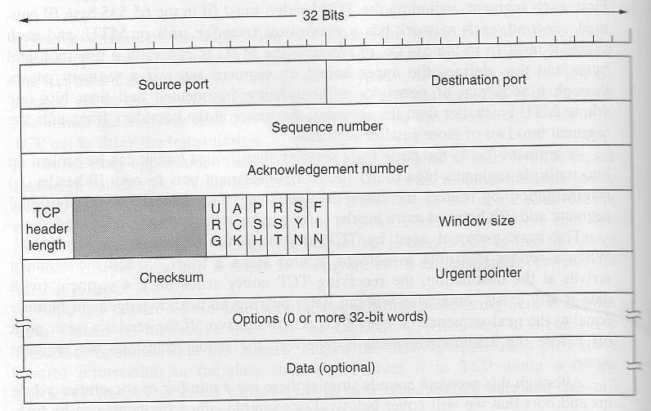
The TCP Segment Header
0
Fig. 1. The TCP header

Slide 15
The TCP Segment Header
0
Source port and Destination port – identify the local end points of the connection.
Sequence number and acknowledgement number (specifies the next sequence number expected)
TCP header length – tells now many 32-bit words are contained in the TCP header (because Options field is of variable length)
Next comes a 6-bit field that is not used.
Next come 6 1-bit flags:
  URG is set to 1 if the Urgent pointer is in use. The Urgent Pointer is used to indicate a byte offset (from the current sequence number) at which urgent data is located
  ACK is set to 1 to indicate that the acknowledgement number field is valid. Otherwise, if set to 0, then this segment does not contain an acknowledgment

Slide 16
The TCP Segment Header
0
  PSH bit indicates PUSHed data. The receiver hereby kindly requested to deliver the data to the application upon arrival and not buffer it (done for efficiency)
  RST bit is used to reset a connection that has become confused due to a host crash or some other reason. It is also used to reject an invalid segment or refuse an attempt to open a connection.
  SYN bit is used to establish connections. SYN=1 and ACK=0 – connection request, SYN=1 and ACK=1 – connection accepted.
  FIN but is used to release a connection. It specifies that the sender has no more data to transmit.
Window size field tells how many bytes may be sent starting at the byte acknowledged.

Slide 17
The TCP Segment Header
0
A Checksum is also provided for extreme reliability – it checksums the header and the data.
Options field was designed to provide a way to add extra facilities not covered by the regular header. For example, allow each host to specify the maximum TCP payload it is willing to accept. (using large segments is more efficient than using small ones)

Slide 18
TCP Connection Management
0
Connections are established in TCP using a three-way handshake:
  Host 1 chooses a sequence number, x, and sends a CONNECTION REQUEST containing it to host 2.
  Host 2 replies with CONNECTION ACCEPTED acknowledgment x, and announcing its own initial sequence number, y.
  Finally Host 1 acknowledges host 2’s choice of an initial sequence number in the first data that it sends.

Slide 19
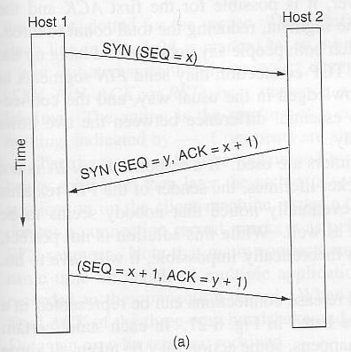
TCP Connection Management
0
To establish a connection, one side, say a server, passively waits for an incoming connection by executing LISTEN and ACCEPT primitives
The other side, say a client, executes a CONNECT primitive, specifying the IP address and port to which it wants to connect, and the max TCP segment size it is willing to accept
The CONNECT primitive sends a TCP segment with the SYN bit = 1 and ACK = 0 and waits for a response
Fig. 2. TCP connection
establishment

Slide 20
TCP Connection Management
0
When this segment arrives at the destination, the TCP entity there checks to see if there is a process that has done a LISTEN on the port given in the Destination port field. If not, it sends a reply with the RST bit on to reject the connection.
If some process is listening on the port, that process is given the incoming TCP segment. It can either accept or reject the connection. If it accepts, an acknowledgment segment is sent back.

Slide 21
TCP Transmission Policy
0
Window management in TCP is not tied to acknowledgments as it is in most data link protocols.
For example:
  suppose that the receiver has a 4095-byte buffer.
  If the sender transmits a 2048-byte segment that is correctly received, the receiver will acknowledge the segment.
  However, since it now has only 2048 of buffer space (until the application removes some data from the buffer), it will advertise a window of 2048 starting a the next byte expected.
  Now the sender transmits another 2048 bytes, which are acknowledged, but the advertised window is 0.
  The sender must stop until the application process on the receiving side has removed some data from the buffer. Then, TCP can advertise a larger window.
  There are two exceptions: urgent data may be sent (ex. to allow user to kill the process), or send 1 byte to make the receiver re-announce the window (in case it was lost)

Slide 22
TCP Congestion Control
0
When the load offered to any networks is more than it can handle, congestion builds up. The Internet is no exception.
Algorithms have been developed over the past decade to deal with congestion.
Although the network layer also tries to manage congestion, most of the heavy lifting is done by TCP because the real solution to congestion is to slow down the data rate.

Slide 23
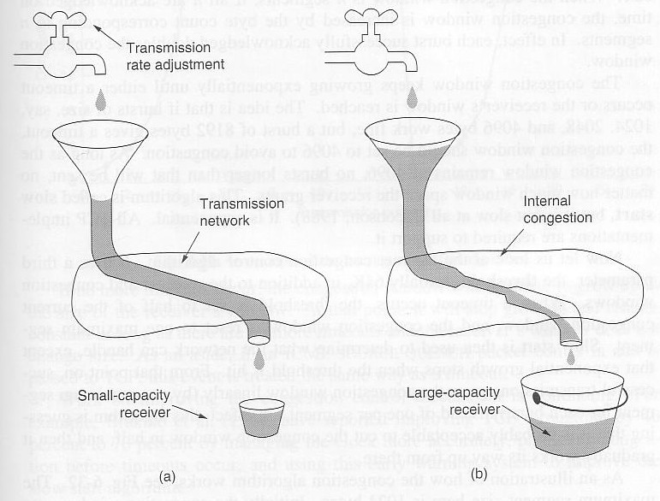
TCP Congestion Control
0
Fig. 3. (a) A fast network feeding a low capacity receiver
(b) A slow network feeding a high capacity receiver

Slide 24
TCP Congestion Control
0
In theory congestion can be dealt with by employing a principle borrowed from physics: the law of conservation of packets. The idea is not to inject a new packet into the network until an old one leaves (i.e. is delivered). TCP attempts to achieve this goal by dynamically manipulating the Window size.

Slide 25
TCP Timer Management
0
TCP uses multiple timers (at least conceptually) to do its work.
The most important of these is the retransmission timer. When a segment is sent, a retransmission timer is started. If the segment is acknowledged before the timer expires, the timer is stopped. If, on the other hand, the timer goes off before the acknowledgment comes in the segment is retransmitted (and the timer started again).
The question that arises is: How long should the timeout interval be?

Slide 26
TCP Timer Management
0
This problem is much more difficult in the Internet transport layer than in the generic data link protocols, where the delay is very predictable.
The solution is to use a highly dynamic statistical algorithm that constantly adjusts the timeout interval based on continuous measurements of network performance. This algorithm was proposed by Jacobson in 1988.

Slide 27
UDP
0
The Internet protocol suite also supports a connectionless transport protocol, UDP (User Data Protocol)
UDP provides a way for applications to send encapsulated raw IP datagrams and send them without having to establish a connection.
Many client-server applications that have 1 request and 1 response use UDP rather than go to the trouble of establishing and later releasing a connection.

Slide 28
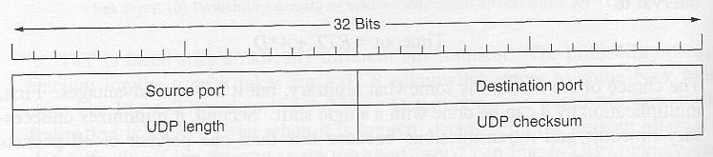
UDP
0
A UDP segment consists of an 8-byte header followed by the data.
Fig. 4. The UDP header

Slide 29
UDP
0
The two ports serve the same function as they do in TCP: to identify the end points within the source and destination machines.
The UDP length field includes the 8-byte header and the data.
The UDP checksum is used to verify the size of header and data.

